Slide 1
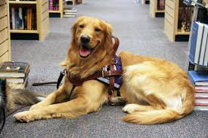
Who Let the Dogs (and Miniature Horses) In? Service Animals in Health Care Facilities

Slide 2
Learning Objectives
Define service animals under the ADA.
List the questions that can be asked about a service animal.
Identify places that a service animal can and cannot visit with his/her handler.
Understand how to interact appropriately with the service animal and its handler.
Recognize the importance of having a service animal policy.

Slide 3
An Overview of the ADA National Network
Notes:
Facilitate voluntary compliance with the Americans with Disabilities Act of 1990 (ADA)
Conduct research to reduce and eliminate barriers to employment and economic self-sufficiency and to increase the civic and social participation of Americans with disabilities

Slide 4
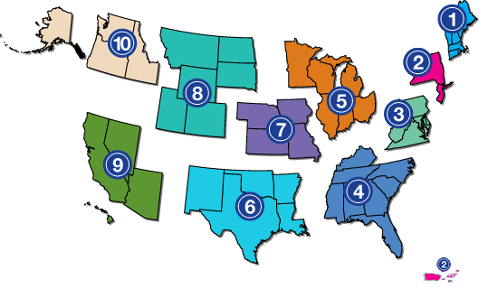
ADA National Network 1-800-949-4232 www.adata.org
Notes:
The Southeast ADA Center is a member of the ADA National Network. The ADA National Network consists of 10 regional centers and an ADA Knowledge Translation Center. The regional centers are distributed throughout the United States to provide local assistance and foster implementation of the ADA. The Network provides information, guidance and training on the Americans with Disabilities Act (ADA), tailored to meet the needs of business, government and individuals at local, regional and national levels. The Network is not an enforcement or regulatory agency, but a helpful resource supporting the ADA's mission to "make it possible for everyone with a disability to live a life of freedom and equality.“
The 10 regional centers along with the ADA Knowledge Translation Center, work together to develop projects and events of national significance. Each regional center also focuses on the specific needs of the residents who reside within its service area. The regional nature of the ADA National Network is critical to ensuring the network can adequately support the diverse population of ADA Stakeholders throughout the country.

Slide 5
Our Funding
Notes:
All Centers in the ADA National Network are funded by the U.S. Department of Health and Human Services, Administration on Community Living, National Institute on Disability, Independent Living, and Rehabilitation Research (NIDILRR). The Centers have been known by different names through the years (DBTACs, ADA & IT Centers, and now ADA Centers), however, our mission has always been the same.

Slide 6
A Brief Look at the Americans with Disabilities Act (ADA)

Slide 7
What is the ADA?
Americans with Disabilities Act
Civil rights law passed in 1990
Promotes equal opportunity for people with disabilities in employment, by state and local government agencies, and by private businesses.
Goal: The full inclusion of people with disabilities in all aspects of American society.

Slide 8
The ADA - Our Nation’s Goals
The ADA clearly states that our nation’s goals regarding individuals with disabilities are to “assure equality of opportunity, full participation, independent living, and economic self-sufficiency.”
Source: ADA Findings and Purposes
Link: eeoc.gov/laws/statutes/ada.cfm

Slide 9
The ADA Applies to:
Employment (Title I);
State and local government programs (Title II);
Public Accommodations [private businesses including non-profit groups] (Title III)
Transportation (Titles II and III)
Telecommunications (Title IV)
Notes:
Employment: Title I
This title focuses on reasonable accommodations - a change in the way work is performed.
State and Local Government: Title II Requires access to services, programs, and activities in public education, corrections and the courts etc.
Places of Public Accommodation: Title III Requires access to goods and services in places such as sober homes, health care facilities and other private businesses and non-profits that serve the public.

Slide 10
ADA Title II - Examples of Health Care Facilities
Hospitals operated by a state and/or local government
Public health care clinics
County department of public health
State-operated mental health clinic
Americans with Disabilities Act Title II Regulations Web link: ada.gov/regs2010/titleII_2010/titleII_2010_regulations.htm Source: U.S. Department of Justice

Slide 11
ADA Title III - Examples of Health Care Facilities
Private hospitals
Urgent care clinics
Doctor's offices
Mental heath care providers
Dentist’s offices
Americans with Disabilities Act Title III Regulations
Web link: ada.gov/regs2010/titleIII_2010/titleIII_2010_regulations.htm
Source: U.S. Department of Justice

Slide 12
What is a reasonable modification?
Term used in Title II of the ADA (state and local government agencies) and Title III of the ADA (public accommodations / private businesses).
Definition: Adjusting policies, practices, and procedures, if needed, to provide goods, services, facilities, privileges, advantages, or accommodations.
Resource: Health Care and the Americans With Disabilities Act Web Link: adata.org/factsheet/health-care-and-ada Source: ADA National Network

Slide 13
Reasonable Modifications and Service Animals
Generally, a public entity or public accommodation shall modify policies, practices, or procedures to permit the use of a service animal by an individual with a disability.
2010 ADA Title II Regulations - § 35.136 (a) Link: ada.gov/regs2010/titleIII_2010/titleIII_2010_regulations.htm#a302 Source: U.S. Department of Justice
2010 ADA Title III Regulations § 36.302(c)(1) Link: ada.gov/regs2010/titleIII_2010/titleIII_2010_regulations.htm#a302 Source: U.S. Department of Justice

Slide 14
What Are Service Animals?

Slide 15
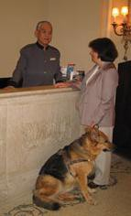
A Service Animal Is Defined As…
Any dog that is individually trained to do work or perform tasks for the benefit of an individual with a disability, including a physical, sensory, psychiatric, intellectual, or other mental disability.

Slide 16
Monkeys and Ferrets and Snakes…Oh my!
Species other than dogs, wild or domestic, trained or untrained, are not considered service animals under this part of the ADA.
Animals such as cats, birds, monkeys, rats, pigs, snakes, or other types of animals do not have to be allowed in health care facilities (unless they are generally allowed, for example, as pets).
However…

Slide 17
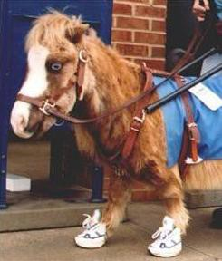
Miniature Horses
Reasonable policy modifications must also be made to allow an individual with a disability to use a miniature horse that has been individually trained to perform work or tasks.

Slide 18
Service Animals are Working and Active
Service dogs or miniature horses must be trained to perform specific actions, tasks, or work.
Many animals, simply by being present, provide comfort, companionship, emotional support, or other benefits, but they are not trained to do anything specific – they are not considered to be service animals under the ADA.
Notes:
Note: having a doctor’s letter stating that someone has a disability and need an animal for emotional support does not make the animal a service animal under the ADA. Neither does an on-line purchased certificate or registration.

Slide 19
Examples of a Service Animal’s Work
Providing physical support and help with balance and stability for people with mobility disabilities.
Guiding individuals who are blind or have low vision.
Pulling a person’s wheelchair.
Retrieving items for a person with a disability.

Slide 20
More Examples of a Service Animal’s Work
Alerting individuals who are deaf or hard of hearing to sounds
Preventing or interrupting impulsive or destructive behaviors for people with psychiatric or neurological disabilities
Alerting individuals to oncoming seizures

Slide 21
Service animals are not pets!
Autism service dog helps to calm the boy during visit to the doctor's office.
Source: Wikimedia Commons
Link: commons.wikimedia.org/wiki/File:Service_Dog_at_doctor%27s_office.jpg

Slide 22
Let’s Compare!
Service Dog
Marge has a psychiatric disability.
Her dog, Harry, can tell when her anxiety level rises.
Harry has been trained to respond by moving himself in front of Marge and nudging her away from her current location.
Pet Dog
Aaron has a psychiatric disability.
His dog, Will, is good-natured. Sometimes, he can even tell that Aaron is becoming anxious.
Will is not trained to do anything to help Aaron.

Slide 23
Dogs or Miniature Horses What’s the Difference?
Service dogs must be allowed in virtually all areas where members of the public are allowed to go
Miniature horses are subject to a few additional considerations …

Slide 24
Miniature Horses: When and Where?
Consider:
The type, size, and weight of the miniature horse and whether the facility can accommodate these features.
Legitimate safety requirements that are necessary for safe operation.

Slide 25
Emotional Support Animals
Emotional Support Animals are not covered by the ADA.
Emotional Support animals provide support to people with multiple disabilities by just being there.
They are not trained to do specific work.

Slide 26
Therapy Animals
Therapy animals are given obedience training and may be trained to provide a specific benefit, however that benefit is not specific to the handler but rather populations of people.
Therapy animals are granted access to places by agreement, not law.
Some states allow therapy animals. Check your state’s law.

Slide 27
Service Animals in a Health Care Facility

Slide 28
Service Animals in a Health Care Facility – Are They Allowed?
Service animals must be allowed access to medical facilities unless the presence of the animal creates a direct threat to other persons or a fundamental alteration in the nature of services.
Guidelines for Environmental Infection Control in Health Care Facilities Web link: cdc.gov/MMWR/preview/MMWRhtml/rr5210a1.htm Source: Centers for Disease Control and Prevention
Notes:
In accordance with the Americans with Disabilities Act, service animals should be permitted to remain with their handlers. If possible, a household member should be designated to care for pets in the home and should follow standard handwashing practices before and after interacting with the household animal. If a person with COVID-19 must care for pets, they should ensure they wash their hands before and after caring for pets
Interim Guidance for Public Health Professionals Managing People With COVID-19 in Home Care and Isolation Who Have Pets or Other Animals
https://www.cdc.gov/coronavirus/2019-ncov/php/interim-guidance-managing-people-in-home-care-and-isolation-who-have-pets.html

Slide 29
Service Animals in a Health Care Facility Making Decisions about Access (slide 1 of 2)
When a decision must be made regarding a service animal's access to any particular area of the health care facility, there are three things to consider.
Guidelines for Environmental Infection Control in Health Care Facilities Web link: cdc.gov/MMWR/preview/MMWRhtml/rr5210a1.htm Source: Centers for Disease Control and Prevention

Slide 30
Service Animals in a Health Care Facility Making Decisions about Access (slide 2 of 2)
evaluate the service animal, patient, and health care situation on a case-by-case basis;
determine whether significant risk of harm exists; and
determine whether reasonable modifications in policies and procedures will mitigate this risk.
Guidelines for Environmental Infection Control in Health Care Facilities Web link: cdc.gov/MMWR/preview/MMWRhtml/rr5210a1.htm Source: Centers for Disease Control and Prevention

Slide 31
Service Animals in a Health Care Facility Separating the Animal from the Handler
If a patient must be separated from his or her service animal while in the health care facility:
determine with the person the arrangements that have been made for supervision or care of the animal during this period of separation; and
make appropriate arrangements to address the patient's needs in the absence of the service animal.
Guidelines for Environmental Infection Control in Health Care Facilities Web link: cdc.gov/MMWR/preview/MMWRhtml/rr5210a1.htm Source: Centers for Disease Control and Prevention

Slide 32
Questions, Questions

Slide 33
What Can You Ask?
Two questions can be asked about dogs or miniature horses when the answers are not obvious:
Is this animal needed because of a disability?
What work or tasks has the animal been trained to do?

Slide 34
Should You Ask the Questions?
Remember –
You should not ask questions if it is apparent that the animal is working for a person with a disability.
For example, a dog is pulling a person in a wheelchair.

Slide 35
Things You May Not Ask
You can not ask for documents, certificates, proof, or details about …
The individual’s disability.
The animal’s training.
Notes:
Sometimes people will tell you exactly what their disabilities are, but if they don’t, remember you can’t ask for specifics or details
“I have a disability and my dog retrieves things for me” is enough
A person does not have to say “I have arthritis and my dog retrieves things for me”

Slide 36
What Can I Expect from a Person with a Disability and the Service Animal?

Slide 37
Housebroken
A service dog or miniature horse must be housebroken.

Slide 38
Tethered and Under Handler’s Control
A service animal must have a harness, leash, or tether unless …
The individual, because of disability, is unable to use a leash; and/or
A leash would interfere with the animal’s work
If a service animal is not tethered, it must still be under control by voice commands or hand signals.

Slide 39
Identification Is Not Required
Many service animals wear harnesses, vests, or other items that identify them as working animals, but this kind of identification is not required.
Remember…certificates, documents, or proof of the service animal’s status or training can not be required.

Slide 40
Excluding a Service Animal
You can ask an individual to remove a service dog or miniature horse if:
The animal is not housebroken
The animal is not under control of the handler
For example: the animal is running around, jumping on people, growling, or snapping, and the individual cannot or will not control the animal.

Slide 41
Allergies and Fear of Dogs
Employees’ or other people’s fear of animals or allergies are not valid reasons to exclude service animals.

Slide 42
Exclude Animals, Not People
When an animal is excluded (for example, when it acts aggressively)…
the individual with a disability must still have the opportunity to access goods and services and participate in activities without the animal.

Slide 43
Care and Supervision
Individuals with disabilities are responsible for the care and supervision of their service animals.
Staff at the health care facility do not have to feed, water, or walk service animals. (unless, of course, your facility accepts pets and you normally provide such services)

Slide 44
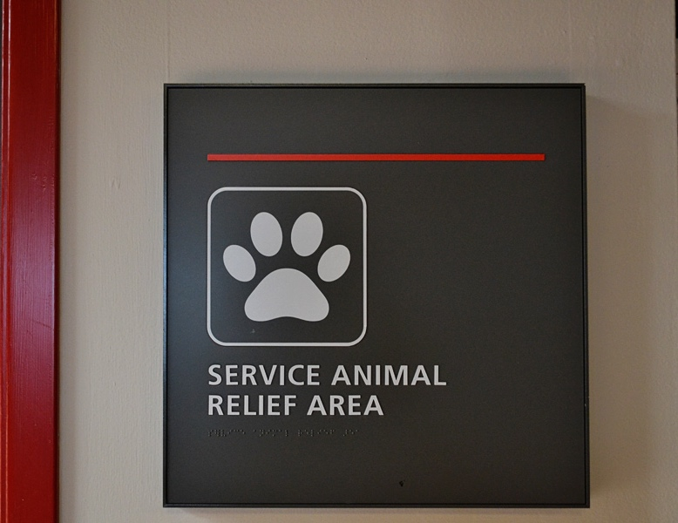
Relief Areas for Service Animals
Although it is not required, you may wish to provide a “relief” area where individuals can take their service animals.
Notes:
It is helpful if staff can provide information about any relief areas or nearby public areas (parks, grassy areas) where people can take their service animals.

Slide 45
What About State or Local Laws?
Health care facilities must comply with all applicable laws.
If a state or local law (or part of one) is better for people with disabilities, it will override the ADA (or that part of it).
If the ADA (or part of it) is better for people with disabilities, it will override a state or local law (or that part of it).
Notes:
For instance, the ADA does not override public health rules that prohibit dogs in swimming pools. However, service animals must be allowed on the pool deck and in other areas where the public is allowed to go.

Slide 46
Surcharges
Extra fees may not be imposed on individuals with service animals, even if your facility accepts pets and charges extra fees for them (Remember! Service animals are not pets!)
You may charge individuals with service animals if the animals actually cause any damages, if you normally charge guests for damages they (or their pets) cause.
Notes:
May want to tell folks that the DOJ has stated service animals are NOT to remain in a guest room if the handler goes out. When this occurs they are no longer under the handler’s control. Source: Frequently Asked Questions about Service Animals and the ADA
https://www.ada.gov/regs2010/service_animal_qa.pdf

Slide 47
Service Animal Sample Policies and Procedures

Slide 48
Are service animal policies required?
Service animal policies are not required.
However, service animal polices are best practice and highly recommended!

Slide 49
Michigan Department of Health and Human Services Service Animal Policy and Forms (ADA Title II)
Service Animal Policy for Hospitals and Facilities Link: dhhs.michigan.gov/OLMWEB/EXF/AP/Public/APF/166.pdf
Service Animal Arrival Checklist - Form MDHHS-5755 Link: michigan.gov/documents/mdhhs/MDHHS-5755_640087_7.dotx
Service Animal Exclusion Assessment - Form MDHHS-5754 Link: michigan.gov/documents/mdhhs/MDHHS-5754_640043_7.dotx

Slide 50
U.S. Department of Justice Settlement Agreement Service Animal Policy (ADA Title III)
Settlement Agreement under the Americans with Disabilities Act Between the United States of America and Dr. Bruce Berenson, M.D., P.A. for Complaint USAO No: 2011-VO-0468 / DJ No. 202-18-267 Link: ada.gov/berenson_settle.htm
**See Attachment A.

Slide 51
Stanford Health Care (California) Service Animal Policy (ADA Title III)
Policy Summary: Service Animals in Stanford Health Care facilities Link: stanfordhealthcare.org/for-patients-visitors/guest-services/service-animal-policy.html
Stanford Hospital and Clinics - Service Animals and Comfort/Emotional Support Dogs – Full Policy (PDF) Link: stanfordhealthcare.org/content/dam/SHC/patientsandvisitors/your-hospital-stay/docs/service-animals-comfort-emotional-support-policy.pdf

Slide 52
The Johns Hopkins Hospital (Maryland) Service Animal Policy (ADA Title III)
The Johns Hopkins Hospital Service Animal Policy Link: hopkinsmedicine.org/the_johns_hopkins_hospital/planning_visit/service_animal.html

Slide 53
Resources

Slide 54
ADA Title II Regulations (State & Local Governments) about Reasonable Modifications
ADA Title II § 35.130(7)(i)
A public entity shall make reasonable modifications in policies, practices, or procedures when the modifications are necessary to avoid discrimination on the basis of disability, unless the public entity can demonstrate that making the modifications would fundamentally alter the nature of the service, program, or activity.
Americans with Disabilities Act Title II Regulations
Web link: ada.gov/regs2010/titleII_2010/titleII_2010_regulations.htm Source: U.S. Department of Justice

Slide 55
ADA Title III (Public Accommodations) Regulations about Reasonable Modification (slide 1 of 2)
ADA Title III Sec. 36.302 Modifications in policies, practices, or procedures.
A public accommodation shall make reasonable modifications in policies, practices, or procedures, when the modifications are necessary to afford goods, services, facilities, privileges, advantages, or accommodations to individuals with disabilities…
Americans with Disabilities Act Title III Regulations
Web link: ada.gov/regs2010/titleIII_2010/titleIII_2010_regulations.htm
Source: U.S. Department of Justice

Slide 56
ADA Title III (Public Accommodations) Regulations about Reasonable Modification (slide 2 of 2)
ADA Title III Sec. 36.302 Modifications in policies, practices, or procedures.
…unless the public accommodation can demonstrate that making the modifications would fundamentally alter the nature of the goods, services, facilities, privileges, advantages, or accommodations.
Americans with Disabilities Act Title III Regulations
Web link: ada.gov/regs2010/titleIII_2010/titleIII_2010_regulations.htm
Source: U.S. Department of Justice

Slide 57
Resources: Service Animals in Health Care Facilities (ADA National Network) (slide 1 of 2)
Service Animals Fact Sheet Link: adata.org/factsheet/service-animals
Service Animals and Emotional Support Animals Booklet Link: adata.org/guide/service-animals-and-emotional-support-animals

Slide 58
Resources: Service Animals in Health Care Facilities (ADA National Network) (slide 2 of 2)
ADA National Network’s Service Animal Resource Hub Link: adata.org/service-animal-resource-hub
Health Care and the Americans With Disabilities Act Link: adata.org/factsheet/health-care-and-ada

Slide 59
Resources: Service Animals in Health Care Facilities (US Department of Justice)
ADA Requirements: Service Animals Link: ada.gov/service_animals_2010.htm
Frequently Asked Questions about Service Animals and the ADA Link: ada.gov/regs2010/service_animal_qa.html

Slide 60
Resources: Service Animals in Health Care Facilities (Centers for Disease Control and Prevention) (slide 1 of 2)
Interim Guidance for Public Health Professionals Managing People with COVID-19 in Home Care and Isolation Who Have Pets or Other Animals Web link: cdc.gov/coronavirus/2019-ncov/php/interim-guidance-managing-people-in-home-care-and-isolation-who-have-pets.html
Guidelines for Environmental Infection Control in Health-Care Facilities Web link: cdc.gov/MMWR/preview/MMWRhtml/rr5210a1.htm

Slide 61
Resources: Service Animals in Health Care Facilities (Centers for Disease Control and Prevention) (slide 2 of 2)
Service Animals in Dental Health Care Settings Link: cdc.gov/oralhealth/infectioncontrol/questions/animals.html

Slide 62
Resources: Service Animals in Health Care Facilities (U.S. Department of Health and Human Services)
Understanding How to Accommodate Service Animals in Healthcare Facilities Link: phe.gov/Preparedness/planning/abc/Pages/service-animals.aspx

Slide 63
Disclaimer (slide 1 of 3)
DISCLAIMER: The contents of this presentation were developed by the Southeast ADA Center under a grant from the National Institute on Disability, Independent Living, and Rehabilitation Research (NIDILRR grant number 90DP0090-01-00). NIDILRR is a Center within the Administration for Community Living (ACL), Department of Health and Human Services (HHS). The contents of this publication do not necessarily represent the policy of NIDILRR, ACL, HHS, and you should not assume endorsement by the Federal Government.

Slide 64
Disclaimer (slide 2 of 3)
The information, materials, and/or technical assistance provided by the Southeast ADA Center are intended solely as informal guidance, and are neither a determination of your legal rights or responsibilities under the ADA, nor binding on any agency with enforcement responsibility under the ADA. The Southeast ADA Center does not warrant the accuracy of any information contained herein. Furthermore, in order to effectively provide technical assistance to all individuals and entities covered by the ADA, NIDILRR requires the Southeast ADA Center to assure confidentiality of communications between those covered and the Center. Any links to non-Southeast ADA Center information are provided as a courtesy, and are neither intended to, nor do they constitute, an endorsement of the linked materials.

Slide 65
Disclaimer (slide 3 of 3)
You should be aware that NIDILRR is not responsible for enforcement of the ADA. For more information or assistance, please contact the Southeast ADA Center via its web site at adasoutheast.org or by calling 1-800-949-4232 or 404-541-9001.

